Slide 1
ECEN 150 Circuit Analysis I
Circuit Theorems

Slide 2
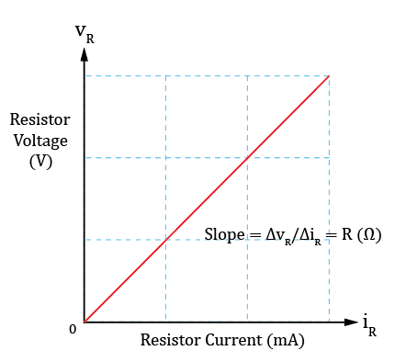
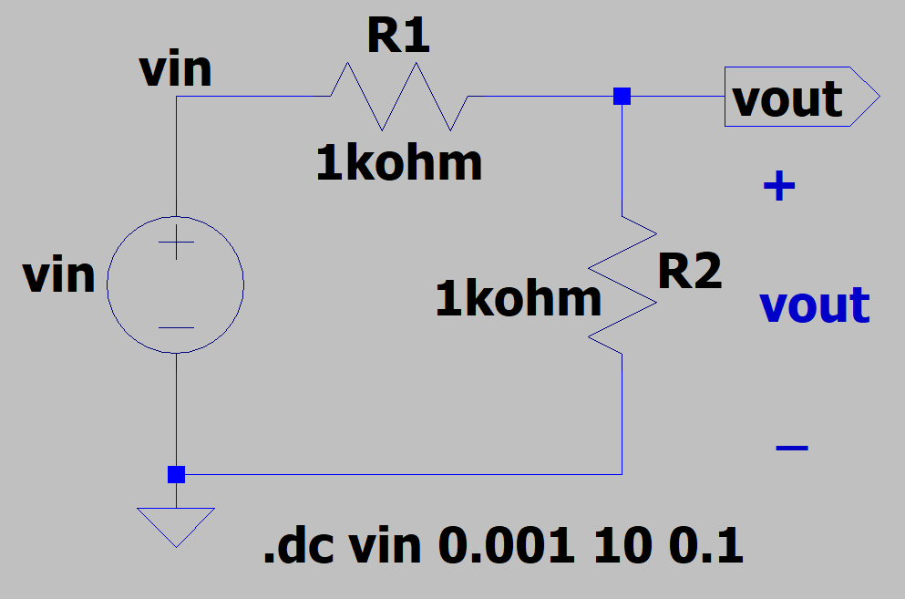
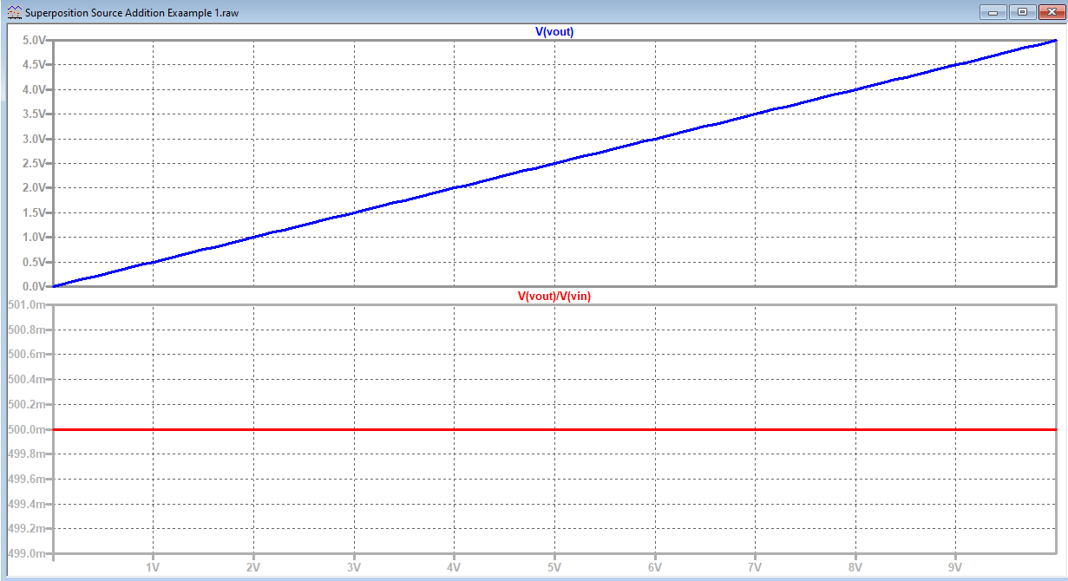

Linearity
Linearity – Linear relationship between cause and effect,
such as v = iR. Resistance R describes the linear relationship
between voltage and current.
A linear circuit is one whose output is linearly related to its input.
$$v_{out}=\frac{v_{in}R_{2}}{R_{1}+{ R}_{2}}=0.5v_{in}. v_{out}=0.5v_{in}.$$
The above linear relationship does not depend on the value of v_{in}, because the circuit is linear.

Slide 3
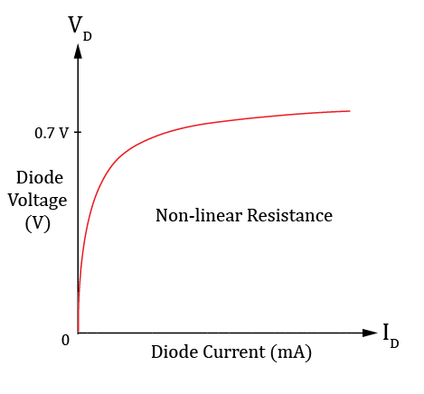
Linearity (Continued)
Linearity – Linear relationship between cause and effect, such as v = iR.
Resistance R describes the linear relationship between voltage and current.
Diodes are examples of non-linear devices, as the slope of voltage-current
relationship changes with the applied voltage.
So diodes do not exhibit a constant resistance, or opposition to current flow.
Non-linear devices like diodes are quite useful in circuits,
yet harder to analyze because they are not linear circuit elements.
Formally, linear circuits posses two properties:
1. Homogeneity (scaling).
Doubling the input doubles the output (Constant slope).
2. Additivity.
Total response to multiple inputs equals sum of the response to individual inputs applied separately.

Slide 4
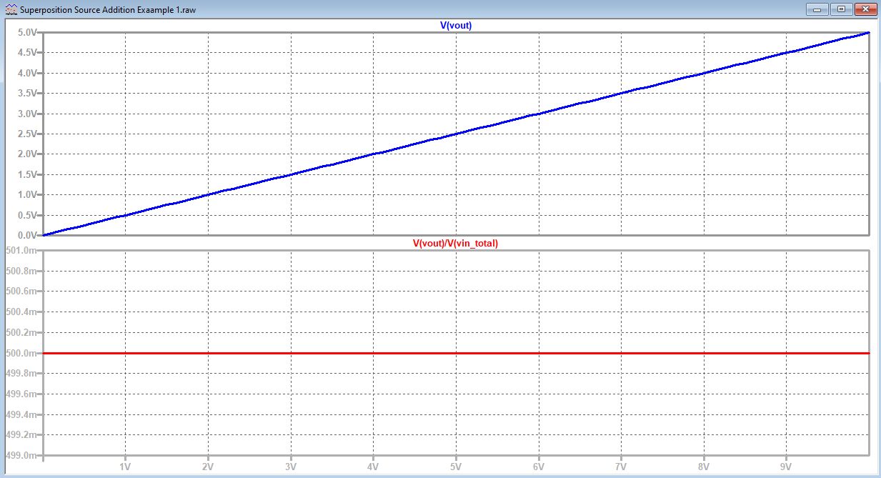
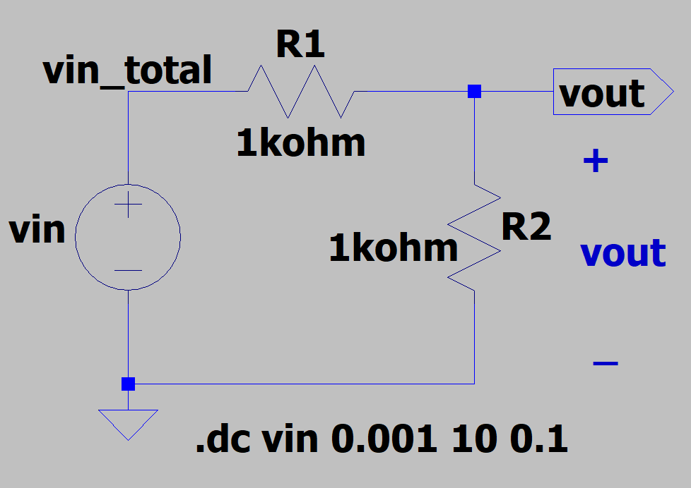
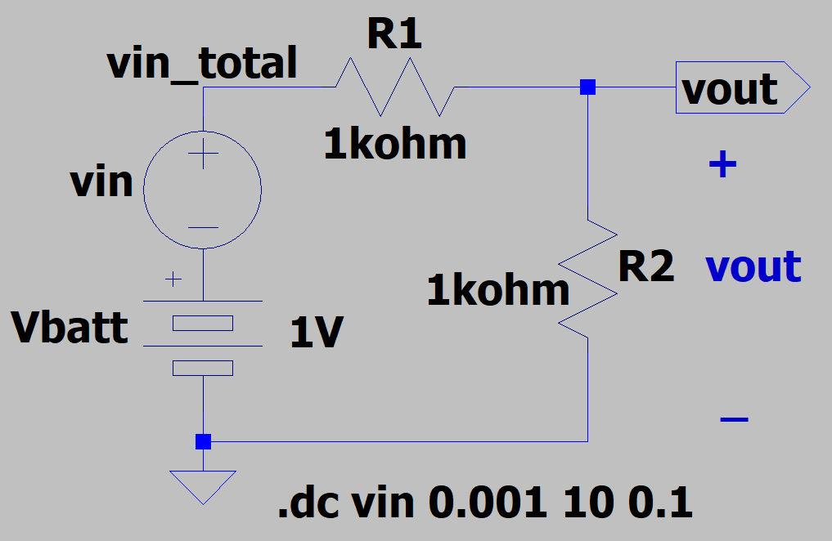
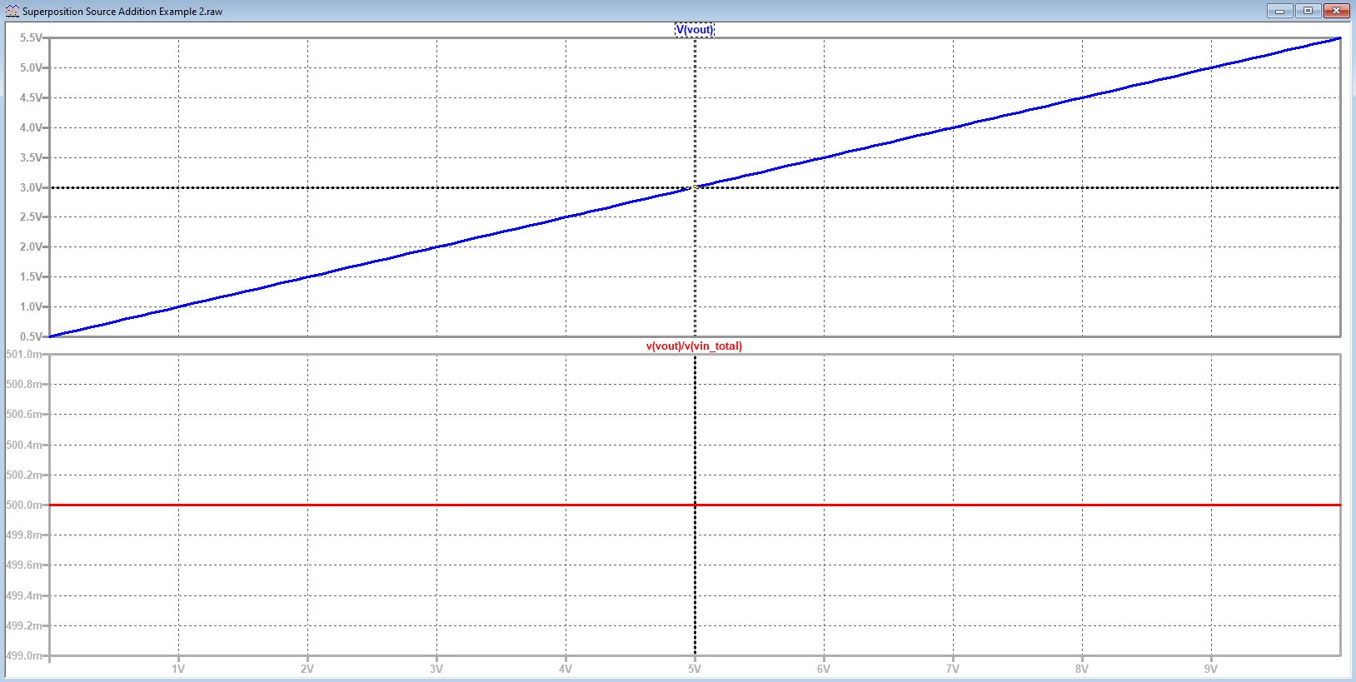

Linearity and Additivity
A linear circuit is one whose output is linearly related to its input.
$$v_{out}=\frac{v_{in_total}R_{2}}{R_{1}+{ R}_{2}}=0.5v_{in_total}. v_{out}=0.5v_{in_total}.$$
A second voltage source does not change the relationship between
v_{out} and v_{in_total}, i.e., $v_{out}=0.5v_{in_total}$, because the circuit is linear. Consequently, the output can also be determined by analyzing each of the two sources independently, then adding the results, with 0.5 V added to v_{out} of top circuit.

Slide 5
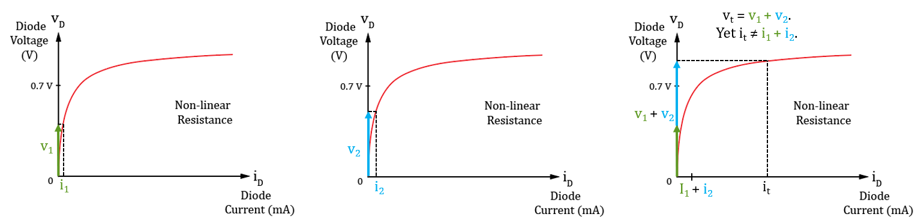
Linearity (Continued)
Why doesn’t homogeneity and additivity apply to non-linear systems?
Because as shown for the diode i-v characteristics, homogeneity (scaling) definitely doesn’t hold true in general. Additivity is similar. Could have two DC voltages applies separately that result in almost zero diode current,
yet when added together the resulting diode current could be much greater than that with separately applied voltages.
Superposition principle founded upon the additivity property of linear systems.

Slide 6
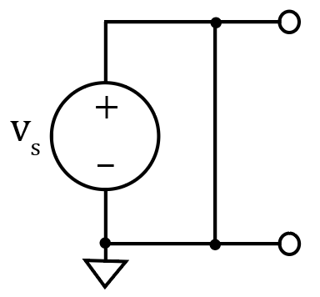
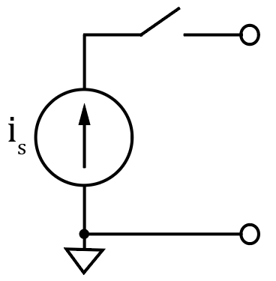
Superposition Principle
The voltage across or current through an element in a linear circuit is the algebraic sum of the voltages across or the currents through that element due to each independent source acting alone. (Additivity property of linear systems).
Good way to solve systems with multiple sources.
Consider each independent source separately, then algebraically sum the results together.
To consider each independent source separately, independent sources not being considered must be turned off.
Dependent sources are left intact because they are controlled by circuit variables.
How do you turn off a voltage source?
Set it equal to zero. Can short across it for schematics to achieve 0 V,
but don’t do this for real circuits.
How do you turn off a current source?
Simply remove it, i.e., open circuit it from the circuit, because a current
source with zero current provides 0 A at all possible voltages, which is
achieved with an open circuit.

Slide 7
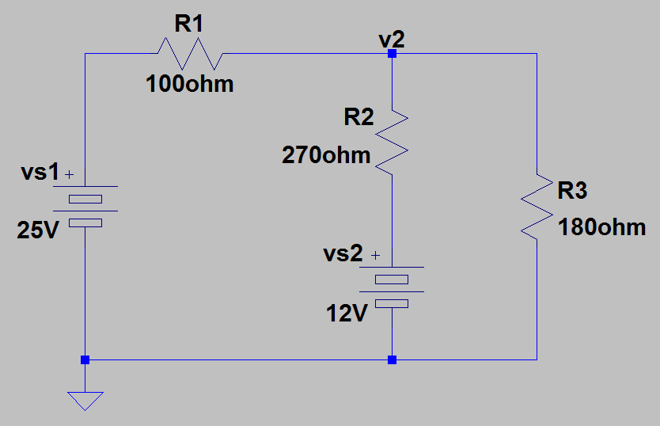
Superposition Example 1
Determine current in resistor R3, i.e., i_{R3}.
Previously solved this problem using nodal analysis
and determined that V₂ = 15.3 V and i_{R3} = 84.9 mA.
Superposition approach:
Part A: Set v_{s2} = 0 with v_{s1} = 25 V and solve for i_{R3}.
ReqA = 100 Ω + R2ǁR3 = 208 Ω. i_{R1A} = (25 V)/(208 Ω) = 120 mA. v_{2A} = 25 V - (120 mA)(100 Ω) = 13.0 V. i_{R3A} = (13.0 V)/(180 Ω) = 72.1 mA.
Part B: Set v_{s1} = 0, with v_{s2} = 12 V and solve for i_{R3}, i.e., i_{R3B}.
ReqB = 270 Ω + R3ǁR1 = 334 Ω. i_{R2B} = (12 V)/(334 Ω) = 35.9 mA. v_{2B} = 12 V - (35.9 mA)(270 Ω) = 2.31 V. i_{R3B} = (2.31 V)/(180 Ω) = 12.8 mA.
i_{R3} = i_{R3A} + i_{R3B} = 72.1 mA + 12.8 mA = 84.9 mA.
Poll Questions
Notes:
Image by instructor

Slide 8
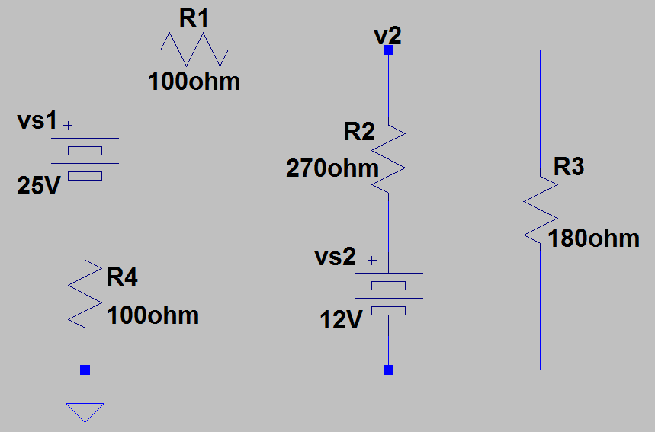
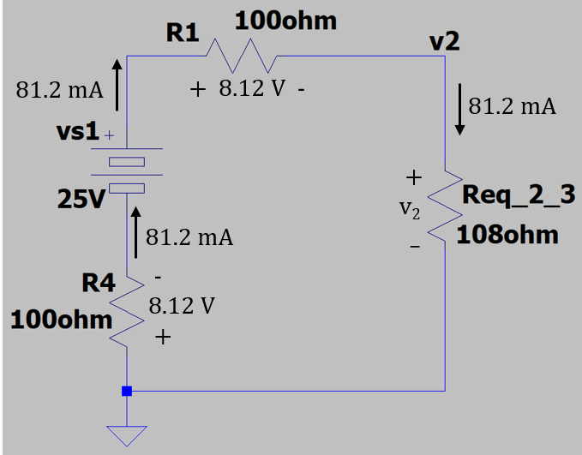
Superposition Example 2
R4 has been added to the previous circuit.
Determine current in resistor R3, i.e., i_{R3}, using superposition.
Part A: Set v_{s2} = 0 with v_{s1} = 25 V and solve for i_{R3}
For part A, i.e., i_{R3A}.
ReqA = 100 Ω + R2ǁR3 + 100 Ω = 308 Ω. i_{R1A} = (25 V)/(308 Ω) = 81.2 mA.
What is the the voltage v_{2A}?
KVL Part A: (81.2 mA)R4 – 25 V + (81.2 mA)R1 + v_{2A} = 0.
v_{2A} = 25 V - (81.2 mA)(100 Ω) - (81.2 mA)(100 Ω).
v_{2A} = 8.77 V.
i_{R3A} = (8.77 V)/(180 Ω) = 48.7 mA.
Notes:
Image by instructor

Slide 9
Superposition Example 2 (Continued)
Determine current in resistor R3, i.e., i_{R3}, using superposition.
From previous slide:
Part A: i_{R3A} = (8.77 V)/(180 Ω) = 48.7 mA.
Part B: Set v_{s1} = 0, with v_{s2} = 12 V and solve for i_{R3B}.
ReqB = 270 Ω + R3ǁ(R1 + R4) = 365 Ω. i_{R2B} = (12 V)/(365 Ω) = 32.9 mA. v_{2B} = 12 V - (32.9 mA)(270 Ω) = 3.12 V. i_{R3B} = (3.12 V)/(180 Ω) = 17.3 mA.
i_{R3} = i_{R3A} + i_{R3B} = 48.7 mA + 17.3 mA = 66.0 mA.
Notes:
Image by instructor

Slide 10
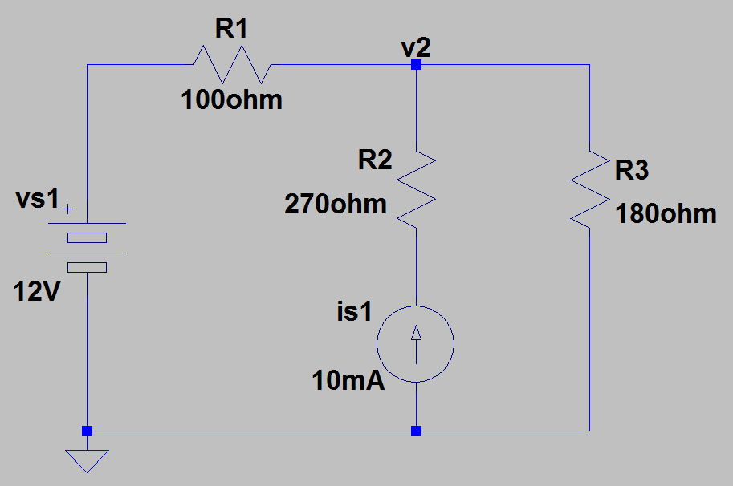
Superposition Example 3
Determine current in resistor R3, i.e., i_{R3} using superposition.
Also determine the power dissipated by resistor R3.
Part A: Set v_{s1} = 0 with i_{s1} = 10.0 mA and
solve for i_{R3A}.
Current Divider: i_{R3A} = i_{R2}R1/(R1 + R3) = 3.57 mA.
i_{R2} = 10.0 mA.
i_{R3A} = (10.0 mA)R1/(R1 + R3) = 3.57 mA.
Another Approach: R1ǁR3 = 64.3 Ω. v_{2A} = (10.0 mA)(64.3 Ω) = 0.643 V. i_{R3A} = (0.643 V)/(180 Ω) = 3.57 mA.
Part B: Set i_{s1} = 0 (open circuit), with v_{s1} = 12 V and solve for i_{R3B}.
ReqB = 100 Ω + 180 Ω = 280 Ω. i_{R3B} = (12 V)/(280 Ω) = 42.9 mA.
i_{R3} = i_{R3A} + i_{R3B} = 3.57 mA + 42.9 mA = 46.5 mA. i_{R3} = 46.5 mA.
Notes:
Image by instructor

Slide 11
Superposition Example 3 (Continued)
Determine current in resistor R3, i.e., i_{R3} using superposition.
Also determine the power dissipated by resistor R3.
p = vi = v²/R = i²R.
i_{R3} = i_{R3A} + i_{R3B} = 46.5 mA. p = i²R =(46.5 mA)²(180 Ω) = 389 mW.
Part A: i_{R3A} = 3.57 mA. p_{A} = (3.57 mA)²(180 Ω) = 2.29 mW.
Part B: i_{R3B} = 42.9 mA. p_{B} =(42.9 mA)²(180 Ω) = 331 mW.
p_{A} + p_{B} =2.29 mW + 331 mW = 336 mW ≠ 389 mW. What is wrong?
Power is not a linear function of voltage and current, i.e., p = vi = v²/R = i²R. Therefore, total power does not obey the Superposition Principle.
In the above circuit, to determine the total power dissipated by resistor R3, we need the total current i_{R3}, or the total voltage v₂, or both to determine the power, which is 389 mW in the previous example.
Superposition can certainly be used to determine the total current and/or voltage necessary to calculate power.
Notes:
Image by instructor

Slide 12
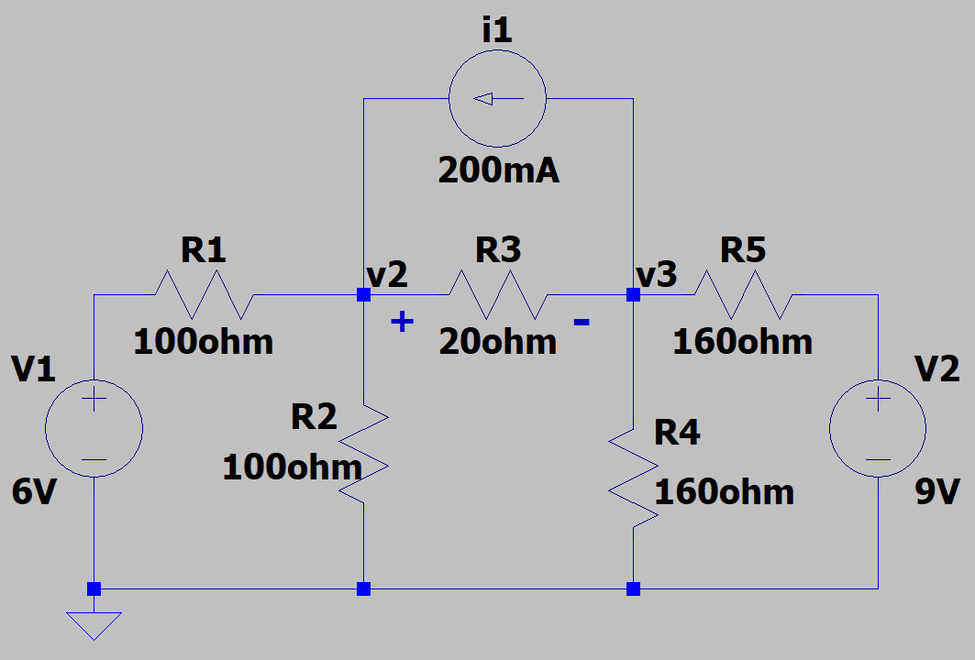
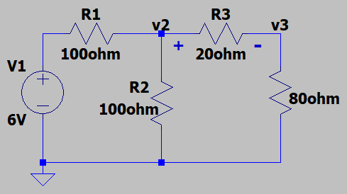
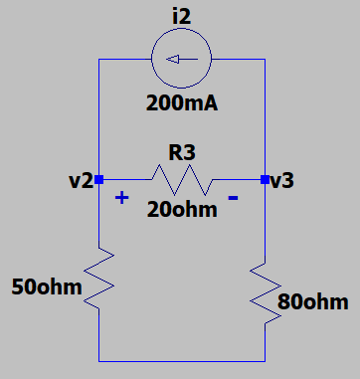
Superposition Example 4
Determine the voltage across resistor R3, i.e., v_{R3} = v₂ - v₃, using
superposition. Also determine the power dissipated by resistor R3.
Part A: Set i₁ (open) and v₂ (short) = 0, and solve for v_{R3A}.
Voltage Divider. v_{2A} = (6 V)(50 Ω)/(150 Ω) = 2.00 V. v_{3A} = (2.00 V)(80 Ω)/(100 Ω) = 1.60 V. v_{R3A} = 2.00 V – 1.60 V = 0.400 V.
Part B: Set v₁ (short) and v₂ (short) = 0, and solve for v_{R3B}.
Current Divider. i_{R3B} = (200 mA)(130 Ω)/(150 Ω) = 173 mA.
v_{R3B} = (173 mA)(20 Ω) = 3.47 V.
Notes:
Image by instructor

Slide 13
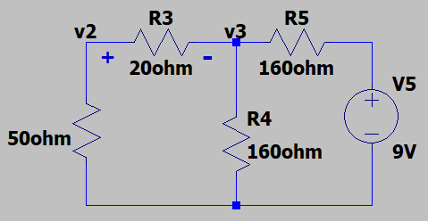
Superposition Example 4 (Continued)
Determine the voltage across resistor R3, i.e., v_{R3} = v₂ - v₃, using
superposition. Also determine the power dissipated by resistor R3.
Part A: v_{R3A} = 0.400 V.
Part B: v_{R3B} = 3.47 V.
Part C: Set i₁ (open) and v₁ (short) = 0, and solve for v_{R3A}.
(70 Ω)ǁ(160 Ω) = 48.7 Ω. 48.7 Ω + 160 Ω = 209 Ω.
Voltage Divider. v_{3C} = (9 V)(48.7 Ω)/(209 Ω) = 2.10 V. v_{2C} = (2.10 V)(50 Ω)/(70 Ω) = 1.50 V. v_{R3C} = 1.50 V – 2.10 V = -0.600 V. v_{R3} = v_{R3A} + v_{R3B} + v_{R3C} = 0.400 V + 3.47 V – 0.600 V = 3.27 V. v_{R3} = 3.27 V.
p_{R3} = v²/R = (3.27 V)²/(20 Ω) = 535 mW. p_{R3} = 535 mW.
Notes:
Image by instructor

Slide 14
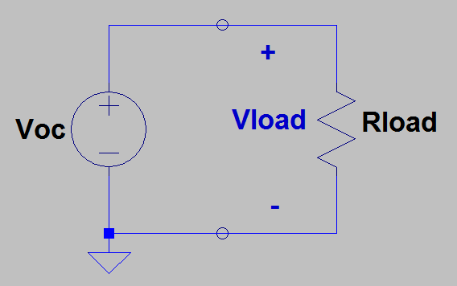
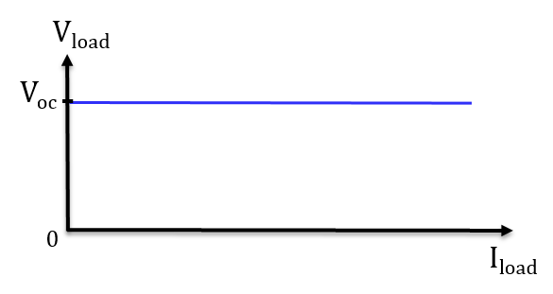
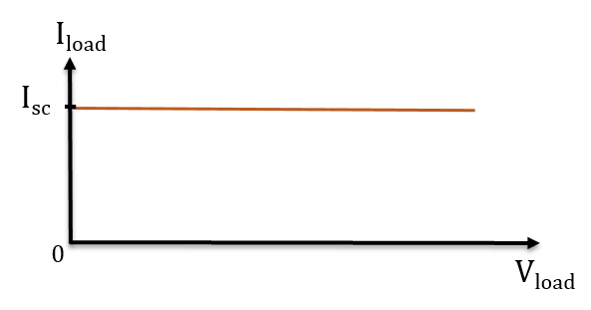
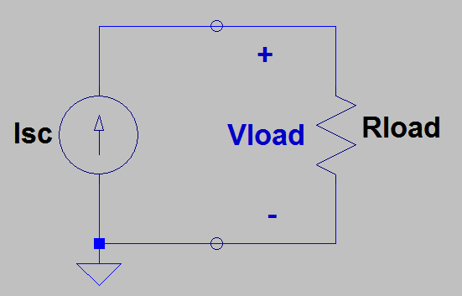
Voltage and Current Sources
An ideal voltage source provides the desired voltage no matter how much current is required.
Hence, an ideal voltage source is independent of current.
An ideal current source provides the desired current no matter how much voltage is required.
Hence, an ideal current source is independent of voltage.
An ideal voltage source provides whatever current is necessary to maintain the desired output voltage, i.e., V_{oc}.
An ideal current source provides whatever voltage is necessary across the output terminals to maintain the desired output current, i.e., i_{sc}.

Slide 15
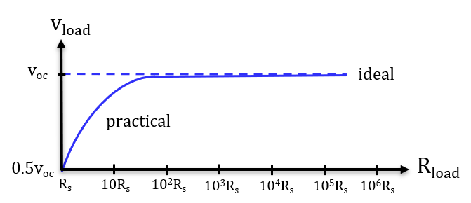
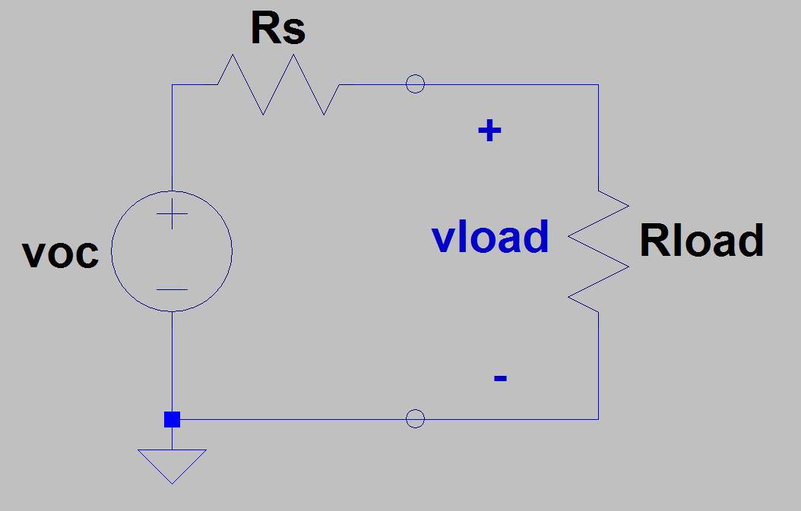
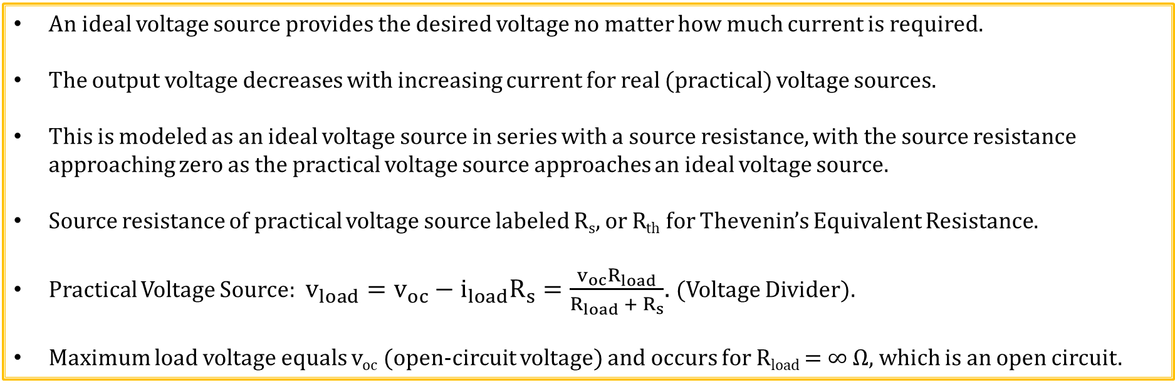
Practical Voltage Sources
An ideal voltage source provides the desired voltage no matter how much current is required.
The output voltage decreases with increasing current for real (practical) voltage sources.
This is modeled as an ideal voltage source in series with a source resistance, with the source resistance approaching zero as the practical voltage source approaches an ideal voltage source.
Source resistance of practical voltage source labeled R_{s}, or R_{th} for Thevenin’s Equivalent Resistance.
Practical Voltage Source: $v_{load}=v_{oc}−i_{load}R_{s}=\frac{v_{oc}R_{load}}{R_{load} +{ R}_{s}}$. (Voltage Divider).
Maximum load voltage equals v_{oc} (open-circuit voltage) and occurs for R_{load} = ∞ Ω, which is an open circuit.

Slide 16
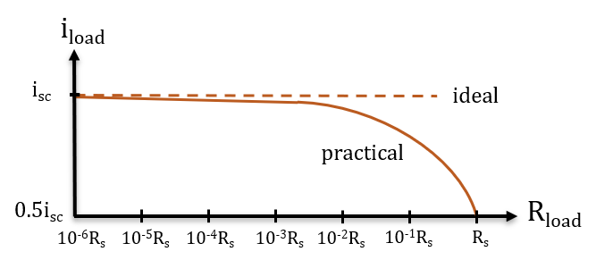
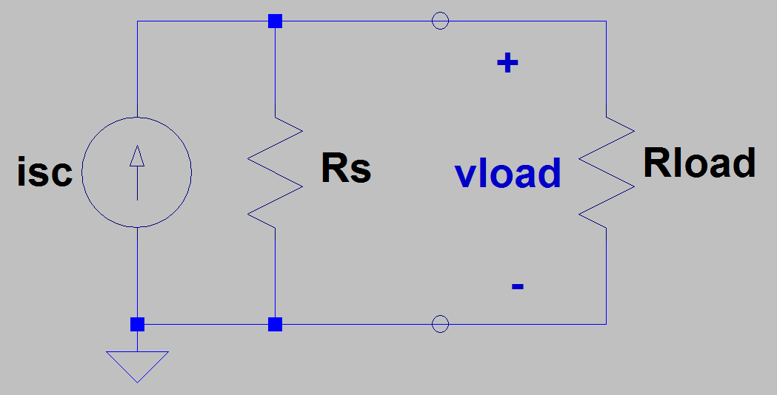
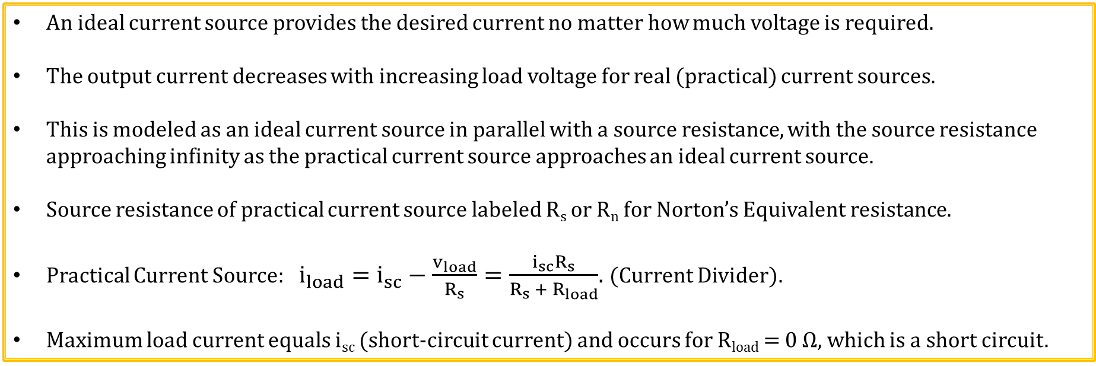
Practical Current Sources
An ideal current source provides the desired current no matter how much voltage is required.
The output current decreases with increasing load voltage for real (practical) current sources.
This is modeled as an ideal current source in parallel with a source resistance, with the source resistance approaching infinity as the practical current source approaches an ideal current source.
Source resistance of practical current source labeled R_{s} or R_{n} for Norton’s Equivalent resistance.
Practical Current Source: $i_{load}=i_{sc}−\frac{v_{load}}{R_{s}}=\frac{i_{sc}R_{s}}{R_{s} +{ R}_{load}}$. (Current Divider).
Maximum load current equals i_{sc} (short-circuit current) and occurs for R_{load} = 0 Ω, which is a short circuit.

Slide 17
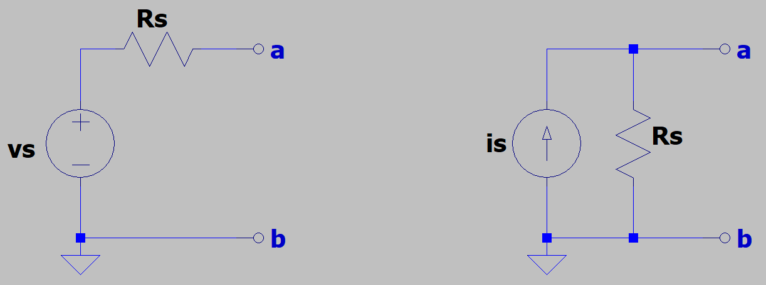
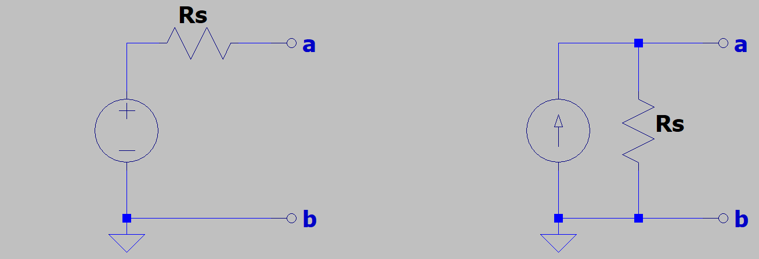
Source Transformations
Source transformations can be used to convert from a practical voltage
source to an equivalent practical current source and vice versa.
Equivalent circuits have identical v-i characteristics as the original
circuit at the output terminals.
All equivalent circuits exhibit the same behavior at the output terminals, even though the internal components can be quite different.
If both sources are turned off in the above circuits, then the equivalent resistance is R_{s}.
How do we find the short-circuit current from the practical voltage source circuit?
Short the a and b terminals which results in a short-circuit current i_{s} = v_{s}/R_{s} for the practical voltage source.
How do we find the open-circuit voltage from the practical current source circuit?
Open the a and b terminals which results in an
open-circuit voltage v_{s} = i_{s}R_{s} for the practical current source.
Source transformation relationships: R_{s} = R_{s}, i_{s} = v_{s}/R_{s}, v_{s} = i_{s}R_{s}.
v_{s} = i_{s}R_{s}
i_{s} = v_{s}/R_{s}
Notes:
Image by instructor

Slide 18
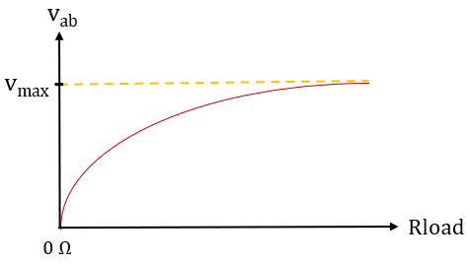
Source Transformations (Continued)
Source transformation relationships: R_{s} = R_{s}, i_{s} = v_{s}/R_{s}, v_{s} = i_{s}R_{s}.
Equivalence means that the v-i characteristics at the a - b terminals are identical with the original circuit for any given load attached, even though the internal circuit components can be different.
Both of the above circuits exhibit the same output voltage versus load
resistance characteristics for any R_{load} attached across the a – b terminals,
as indicated in the above graph.
Open-circuit voltage equals v_{max} = v_{s} for the practical voltage source.
Open-circuit voltage equals v_{max} = i_{s}R_{s} for the practical current source.
Short-circuit current equals v_{s}/R_{s} for the practical voltage source.
Short-circuit current equals i_{s} for the practical current source.
v_{s} = i_{s}R_{s}
i_{s} = v_{s}/R_{s}
Poll Questions

Slide 19
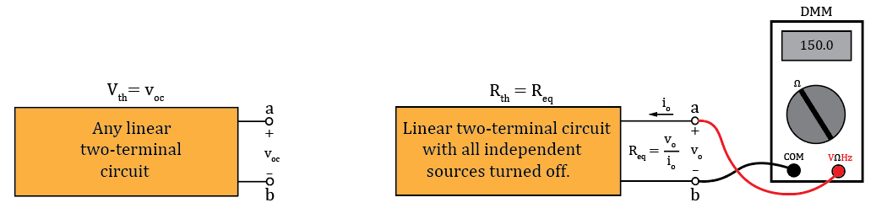
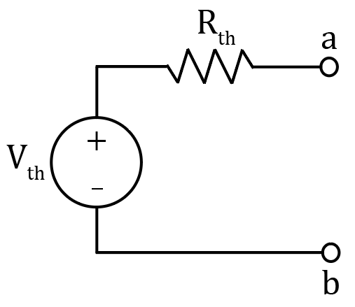
Thevenin’s Theorem
Sometimes, we only care about what happens at the output terminals of a given circuit when connected to some load. Thevenin’s and Norton’s Theorems provide simplified equivalent circuits for any linear circuit having two output terminals.
Thevenin’s Theorem: Any linear two-terminal circuit can be replaced by a voltage source (V_{th}) in series with a resistance (R_{th}). The voltage source (V_{th}) is the open-circuit voltage at the output terminals and the resistance (R_{th}) is the equivalent resistance between the output terminals with all independent sources turned off.
A Thevenin’s Equivalent circuit is a practical voltage source.
The resulting Thevenin’s equivalent circuit provides equivalent
performance as the original circuit with regards to an external loads.
Thevenin’s Theorem Diagrams
Notes:
Image by instructor

Slide 20
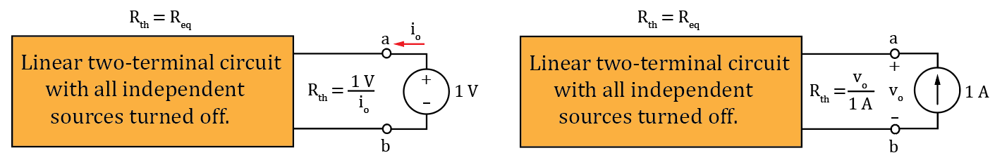
Thevenin’s Theorem (Continued)
Any dependent sources are to be left on when finding R_{th} because they are controlled by circuit variables.
The Thevenin resistance R_{th} simply equals the equivalent resistance of all circuit resistors when the circuit does not have any dependent sources.
When there are dependent sources, then the resulting Thevenin resistance R_{th} can be calculated from R_{th} = v_{o}/i_{o}, resulting from applying either a known voltage source, or known current source to the a – b output terminals. To make the math easy, use a 1 V or 1 A source.
Thevenin’s Theorem Diagrams
Notes:
Image by instructor

Slide 21
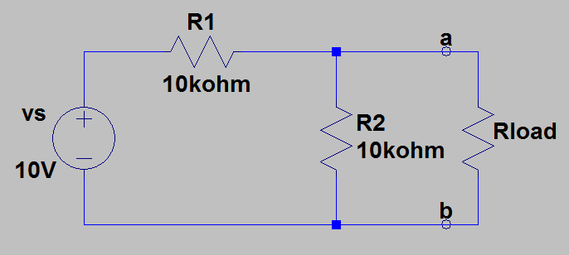
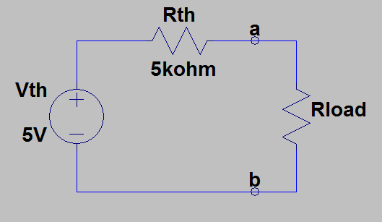
Thevenin’s Theorem Example 1
Find the Thevenin’s equivalent circuit to the left of a – b
terminals for the adjacent circuit.
First remove Rload, to open-circuit the a – b terminals
to find V_{th} = v_{oc} and R_{th}.
V_{th} = v_{ab} = v_{s}R2/(R1 + R2).
V_{th} = (10 V)(10 kΩ)/(20 kΩ) = 5.0 V. V_{th} = 5.0 V.
R_{th} = R1ǁR2 = (10 kΩ)(10 kΩ)/(20 kΩ) = 5 kΩ. R_{th} = 5 kΩ.
Now we can apply the load to the output and solve for load voltages
and currents using simplified Thevenin’s equivalent.
While the above circuits are not equal, they both provide equivalent
performance at the a - b terminals. Hence they are equivalent circuits.
Notes:
Image by instructor

Slide 22
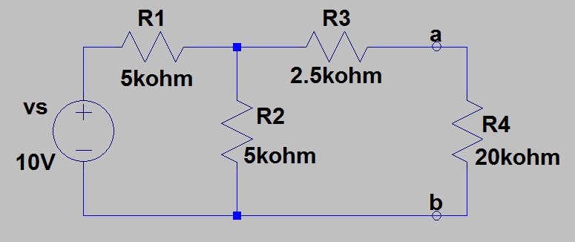
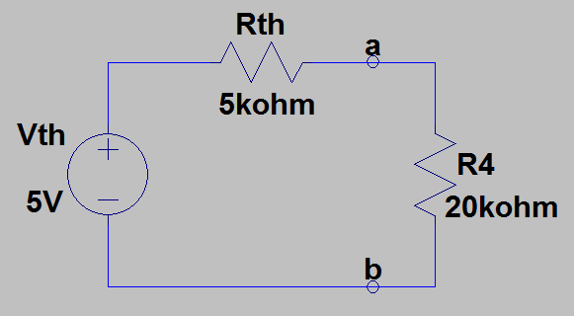
Thevenin’s Theorem Example 2
Find the current through resistor R4 in the adjacent circuit by
finding the Thevenin’s equivalent circuit to the left of a – b terminals.
First remove the load R4, to open-circuit the a – b terminals
to find V_{th} and R_{th}.
V_{th} = v_{ab} = v_{s}R2/(R1 + R2)
V_{th} = (10 V)(5 kΩ)/(10 kΩ) = 5.0 V.
V_{th} = 5.0 V.
R_{th} = R1ǁR2 + R3 = (5 kΩ)(5 kΩ)/(10 kΩ) + 2.5 kΩ = 5 kΩ. R_{th} = 5 kΩ.
Note this is the same Thevenin circuit as the previous example. Theoretically,
an infinite number of circuits can have the same Thevenin equivalent.
Next connect the load R4 to the Thevenin equivalent circuit to solve for i_{R4}.
v_{R4} = V_{th}(20 kΩ)/(R_{th} + 20 kΩ) = 4.0 V. v_{R4} = 4.0 V.
i_{R4} = v_{R4}/(20 kΩ) = (4.0 V)/(20 kΩ) = 200 µA.
Notes:
Image by instructor

Slide 23
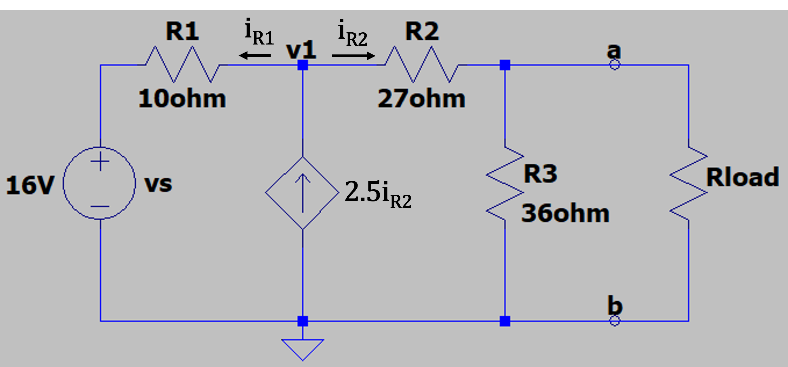
Thevenin’s Theorem Example 3
Find the Thevenin’s equivalent circuit to the
left of the a – b terminals for the adjacent circuit.
First remove R_{load} to find V_{th} and R_{th}.
With R_{load} removed, v_{oc} = V_{th} = i_{R2}R3 = i_{R2}(36 Ω).
We need to solve for i_{R2} to determine V_{th}.
KCL at node v1: i_{R1} = 2.5i_{R2} – i_{R2} = 1.5i_{R2}. i_{R1} = 1.5i_{R2}.
KVL for the 16 V → R1 → R2 → R3 loop:
-16 V - 1.5i_{R2}R1 + i_{R2}R2 + i_{R2}R3 = 0, i_{R2}(-1.5R1 + R2 + R3) = 16 V, i_{R2} = (16 V)/(R2 + R3 – 1.5R1).
i_{R2} = (16 V)/(48 Ω) = 333 mA. i_{R2} = 333 mA.
V_{th} = v_{oc} = (333 mA)(36 Ω) = 12.0 V. V_{th} = 12.0 V.
Notes:
Image by instructor

Slide 24
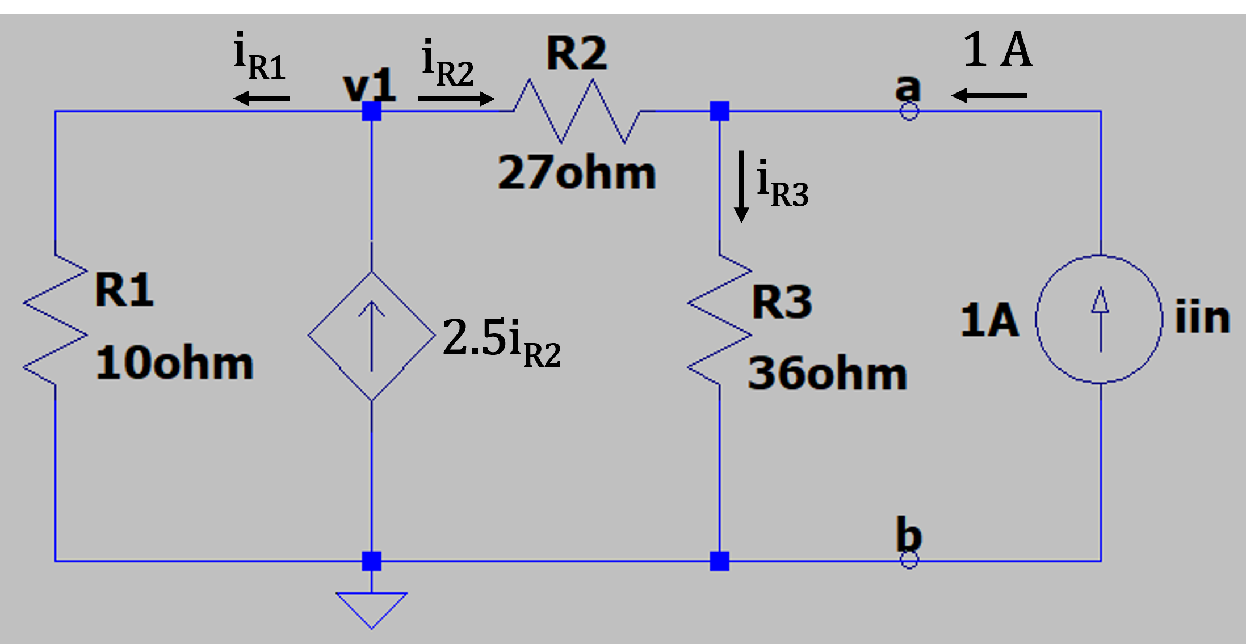
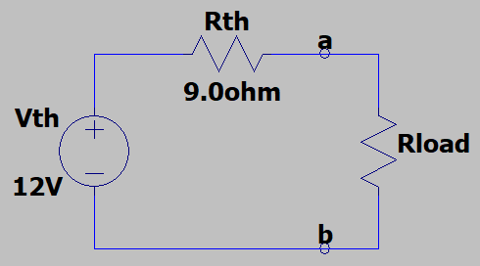
Thevenin’s Theorem Example 3 (Continued)
From the previous slide: V_{th} = 12.0 V.
Next find R_{th} by setting independent sources to zero, while leaving the
dependent sources intact.
Since this circuit has a dependent source, which is a current-controlled
current source, apply a 1 A current source to the a - b terminals to determine R_{th}.
v_{in} = v_{R3} = i_{R3}(36 Ω). i_{R3} = i_{R2} + 1 A. i_{R1} = 2.5i_{R2} – i_{R2} = 1.5i_{R2}. i_{R1} = 1.5i_{R2}.
KVL for the R1 → R2 → R3 loop:
-1.5i_{R2}R1 + i_{R2}R2 + i_{R3}R3 = 0, i_{R2}(-1.5R1 + R2) + (i_{R2} + 1 A)R3 = 0.
i_{R2}(-1.5R1 + R2 + R3) + 36 V = 0,
i_{R2}(-15 Ω + 27 Ω + 36 Ω) = -36 V, i_{R2} = (-36 V)/(48 Ω) = -0.75 A.
i_{R3} = i_{R2} + 1 A = -0.75 A + 1.0 A = 0.25 A. v_{in} = v_{R3} = i_{R3}(36 Ω) = (0.25 A)(36 Ω) = 9.0 V.
R_{th} = v_{in}/(1 A) = (9.0 V)/(1 A) = 9.00 Ω. R_{th} = 9.00 Ω.
Notes:
Image by instructor

Slide 25
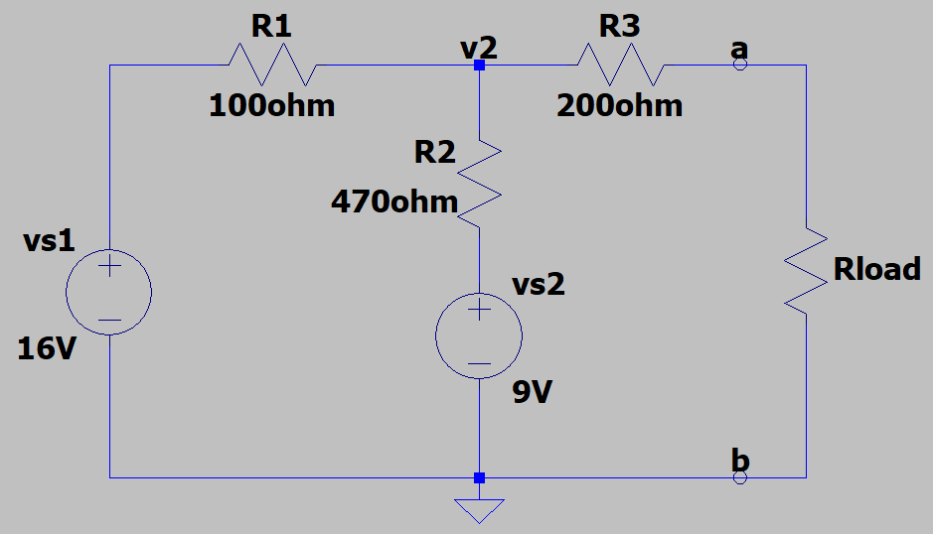
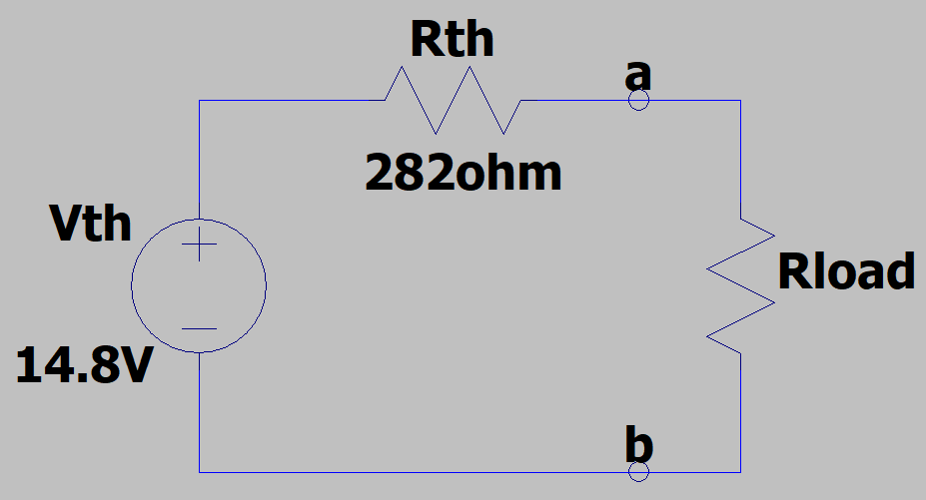
Thevenin’s Theorem Example 4
Find the Thevenin’s equivalent circuit to the left of the
a – b terminals for the adjacent circuit
First remove R_{load} to find V_{th} and R_{th}.
For R_{load} removed, i_{R3} = 0, resulting in i_{R1} = i_{R2},
i.e., 1 equation for 1 unknown.
Solve for v₂ using KVL with node b as reference node:
-v_{s1} + i₁R1 + i₁R2 + v_{s2} = 0, v_{s1} – v_{s2} = i₁(R1 + R2).
i₁ = (7 V)/(570 Ω) = 12.3 mA.
v_{ab} = v₂ = 16 V – (12.3 mA)(100 Ω) = 14.77 V ≈ 14.8 V.
V_{th} = v_{ab} = 14.8 V.
Next set v_{s1} and v_{s2} to zero (short) and find R_{th}.
R_{th} = R3 + R1ǁR2 = 200 Ω + 82.5 Ω = 282 Ω. R_{TH} = 282 Ω.
V_{th} = 14.8 V. R_{th} = 282 Ω.
Notes:
Image by instructor

Slide 26
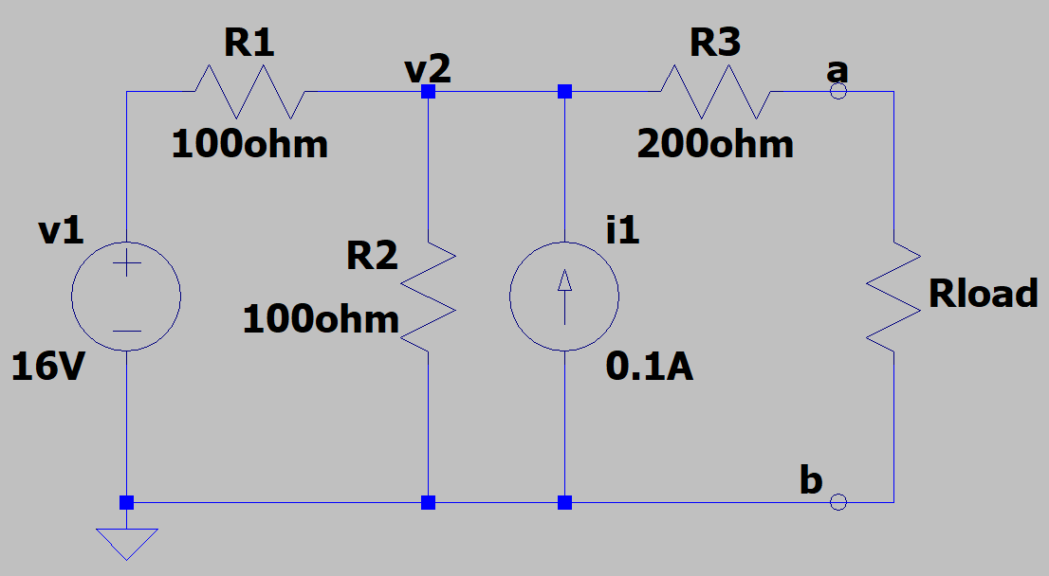
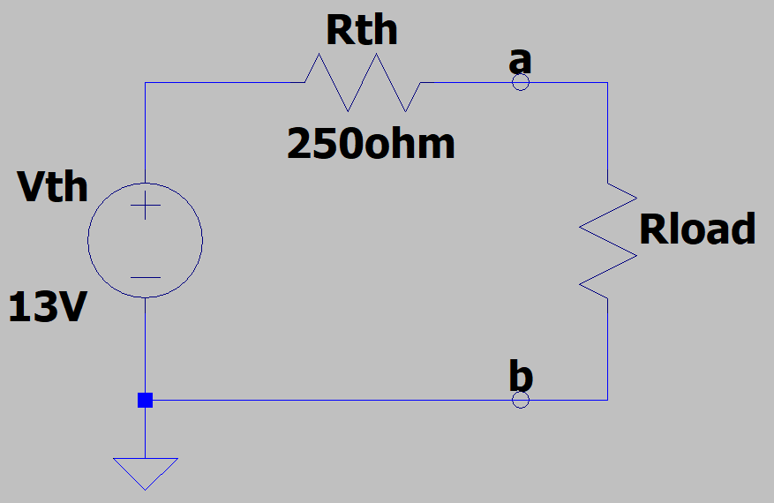
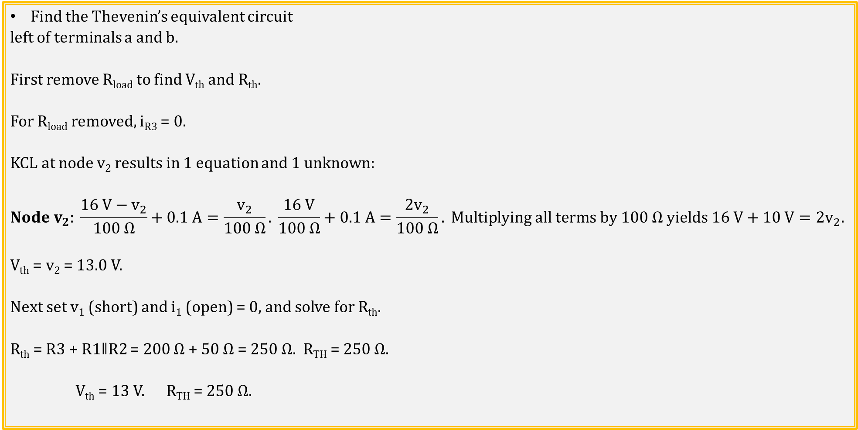
Thevenin’s Theorem Example 5
Find the Thevenin’s equivalent circuit
left of terminals a and b.
First remove R_{load} to find V_{th} and R_{th}.
For R_{load} removed, i_{R3} = 0.
KCL at node v₂ results in 1 equation and 1 unknown:
$$Node v_{2}: \frac{16 V−v_{2}}{100 Ω}+0.1 A=\frac{v_{2}}{100 Ω}. \frac{16 V}{100 Ω}+0.1 A=\frac{{2v}_{2}}{100 Ω}. Multiplying all terms by 100 Ω yields 16 V+10 V=2v_{2}.$$
V_{th} = v₂ = 13.0 V.
Next set v₁ (short) and i₁ (open) = 0, and solve for R_{th}.
R_{th} = R3 + R1ǁR2 = 200 Ω + 50 Ω = 250 Ω. R_{TH} = 250 Ω.
V_{th} = 13 V. R_{TH} = 250 Ω.
Notes:
Image by instructor

Slide 27
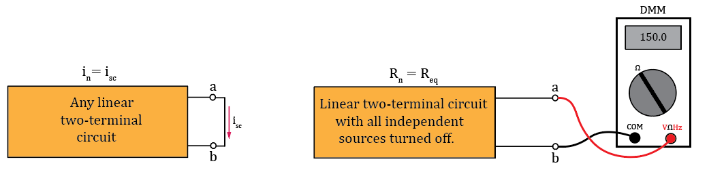

Norton’s Theorem
Norton’s Theorem: Any linear two-terminal circuit can be replaced by a current source (I_{n}) in parallel with a resistance (R_{n}). The current source (I_{n}) is the short-circuit current at the output terminals and the resistance (R_{n}) is the equivalent resistance between the output terminals with all independent sources turned off.
A Norton’s Equivalent circuit is a practical current source.
The resulting Norton’s equivalent circuit provides equivalent
performance as the original circuit with regards to an external load.
The Norton resistance R_{n} is equivalent to the Thevenin resistance R_{th}.
Norton’s Theorem Diagrams
Notes:
Image by instructor

Slide 28

Norton’s Theorem (Continued)
Any dependent sources are to be left on when finding R_{n} because they are controlled by circuit variables.
The Norton resistance R_{n} simply equals the equivalent resistance of all circuit resistors when the circuit does not have any dependent sources.
When there are dependent sources, then the resulting Norton resistance R_{n} can be calculated from R_{n} = v_{o}/i_{o}, resulting from applying either a known voltage source, or known current source to the a – b output terminals. To make the math easy, use a 1 V or 1 A source.
Norton’s Theorem Diagrams
Notes:
Image by instructor

Slide 29


Norton’s Theorem Example 1
Find the Norton’s equivalent circuit to the left of the
a – b terminals for the adjacent circuit.
First remove R_{load} and then short-circuit the a - b terminals
to find I_{n}.
I_{n} = v_{s}/(R1 + R3) = (10 V)/(20 kΩ)
I_{n} = 0.5 mA. I_{n} = 0.5 mA.
Next remove the a – b terminal short, set v_{s}= 0, and look into the a – b terminals to determine R_{n}.
R_{n} = (R1 + R3)ǁR2.
R_{n} = (20 kΩ)(10 kΩ)/(20 kΩ + 10 kΩ) = 6.67 kΩ.
R_{n} = 6.67 kΩ.
Now we can apply the load to the output and solve for load voltages
and currents using simplified Norton’s equivalent.
Notes:
Image by instructor

Slide 30


Norton’s Theorem Example 2
Find the current through resistor R4 in the adjacent circuit by
finding the Norton’s equivalent circuit to the left of a – b terminals.
First remove R4 and then short-circuit the a - b terminals to find I_{n}.
R2ǁR3 = 1.67 kΩ.
v_{R2} = (10 V)(1.67 kΩ)/(6.67 kΩ) = 2.50 V.
I_{n} = v_{R2}/R3 = (2.50 V)/(2.5 kΩ) = 1.00 mA. I_{n} = 1.00 mA.
Next remove the a – b terminal short, set v_{s}= 0, and look into the a – b terminals to determine R_{n}.
R_{n} = R1ǁR2 + R3 = (5 kΩ)(5 kΩ)/(10 kΩ) + 2.5 kΩ.
R_{n} = 5.0 kΩ.
Next connect the load R4 to the Norton equivalent to solve for v_{R4}.
i_{R4} = I_{n}(5 kΩ)/(5 kΩ + 20 kΩ) = 200 µA. v_{R4} = i_{R4}R4 = (200 µA)(20 kΩ) = 4.0 V. v_{R4} = 4.0 V.
i_{R4} = v_{R4}/(20 kΩ) = (4.0 V)/(20 kΩ) = 200 µA. (Same results as with Thevenin’s Theorem.)
Poll Questions
Notes:
Image by instructor

Slide 31
Norton’s Theorem Example 3
Find the Norton’s equivalent circuit to the
left of the a – b terminals for the adjacent circuit.
First remove R_{load} then short-circuit the a - b terminals
to find I_{n}.
I_{n} = i_{R2}.
We need to solve for i_{R2} to determine I_{n}.
KCL at node v1: i_{R1} = 2.5i_{R2} – i_{R2} = 1.5i_{R2}. i_{R1} = 1.5i_{R2}.
KVL for the 16 V → R1 → R2 → Short loop:
-16 V - 1.5i_{R2}R1 + i_{R2}R2 = 0, i_{R2}(-1.5R1 + R2) = 16 V, i_{R2} = (16 V)/(R2 – 1.5R1).
i_{R2} = (16 V)/(12 Ω) = 1.33 A. i_{R2} = 1.33 A.
I_{n} = i_{R2}. = 1.33 A.
Notes:
Image by instructor

Slide 32


Norton’s Theorem Example 3 (Continued)
From the previous slide: I_{n} = i_{R2} = 1.33 A.
Next find R_{n} by setting independent sources to zero, while leaving the
dependent sources intact.
We previously solved for R_{th} by applying a 1 A current source to the a - b
terminals. For variety, this time apply a 1 V voltage source to the a – b terminals.
i_{R3} = (1.0 V)/(36 Ω) = 27.8 mA. i_{R1} = 2.5i_{R2} – i_{R2} = 1.5i_{R2}. i_{R1} = 1.5i_{R2}.
KVL for the R1 → R2 → v_{in} loop:
-1.5i_{R2}R1 + i_{R2}R2 + 1 V = 0, i_{R2}(-1.5R1 + R2) = -1 V, i_{R2}(-15 Ω + 27 Ω) = -1 V.
i_{R2} = (-1 V)/(12 Ω) = -83.3 mA.
i_{R3} = i_{R2} + i_{in}. i_{in} = i_{R3} – i_{R2} = 27.8 mA - -83.3 mA = 111 mA.
R_{n} = (1 V)/(111 mA) = 9.00 Ω. R_{n} = 9.00 Ω. Same result as R_{th} determined from an
applied current source.
Notes:
Image by instructor

Slide 33


Thevenin’s and Norton’s Source Transformations
The Thevenin’s and Norton’s equivalent of the adjacent
circuit were both previously derived and given as follows:
Source transformation of the above Thevenin
equivalent gives i_{sc} = I_{n} = (5 V)/(5 kΩ) = 1 mA,
with R_{n} = R_{th} = 5 kΩ.
Source transformation of the above Norton
equivalent gives v_{oc} = V_{th} = (1 mA)(5 kΩ) = 5 V,
with R_{n} = R_{th} = 5 kΩ.
Green trace in lower plot pane is for the power p = vi
delivered from the Thevenin’s or Norton’s equivalent to
the load resistance.
Notes:
Image by instructor

Slide 34


Maximum Power Theorem
Maximum Power Theorem - Maximum output power to the
load is obtained from a practical source when the load resistance
is equal to the Thevenin or Norton Resistance of the source.
Important implications for audio speakers, transmitting antennas, etc.
Adjacent graph shows v_{load}, i_{load} and p_{load} = v_{load}i_{load} from above circuit as load resistance is swept in value from 0.1 Ω to 250 Ω.
The graph shows that the maximum power equals 500 mW and occurs when R_{load} = R_{th}, as given by the Maximum Power Theorem.
Notes:
Image by instructor

Slide 35


Maximum Power Theorem (Continued)
Maximum Power Theorem - Maximum output power to the
load is obtained from a practical source when the load resistance
is equal to the Thevenin or Norton Resistance of the source.
$$p_{load}= i^{2}R_{load}={\left(\frac{V_{th}}{R_{th}+R_{load}}\right)}^{2}R_{load}. p_{load}= V_{th}^{2}\left[\frac{R_{load}}{{\left(R_{th}+R_{load}\right)}^{2}}\right].$$
$$Quotient Rule:For y= \frac{u}{v}, then \frac{dy}{dx}=\frac{v\frac{du}{dx}−u\frac{dv}{dx}}{v^{2}}. Let u=R_{load}, and v={\left(R_{th}+R_{load}\right)}^{2}.$$
$$Quotient Rule: \frac{d\left(\frac{R_{load}}{{\left(R_{th}+R_{load}\right)}^{2}}\right)}{dR_{load}}= \frac{1{\left(R_{th}+R_{load}\right)}^{2}−R_{load}2\left(R_{th}+R_{load}\right)}{{\left(R_{th}+R_{load}\right)}^{4}}.$$
$$\frac{dp_{load}}{dR_{load}}=V_{th}^{2}\left\{\frac{{\left(R_{th}+R_{load}\right)}^{2}−2R_{load}\left(R_{th}+R_{load}\right)}{{\left(R_{th}+R_{load}\right)}^{4}}\right\}=V_{th}^{2}\left(R_{th}+R_{load}\right)\left\{\frac{R_{th}+R_{load}−2R_{load}}{{\left(R_{th}+R_{load}\right)}^{4}}\right\}.$$
$$\frac{dp_{load}}{dR_{load}}=V_{th}^{2}\left\{\frac{R_{th}−R_{load}}{{\left(R_{th}+R_{load}\right)}^{3}}\right\}.$$
Notes:
Image by instructor

Slide 36

Maximum Power Theorem (Continued)
$$\frac{dp_{load}}{dR_{load}}=V_{th}^{2}\left\{\frac{R_{th}−R_{load}}{{\left(R_{th}+R_{load}\right)}^{3}}\right\}. Maximum or minimum occurs for\frac{dp_{load}}{dR_{load}}=0, which happens for R_{load}=R_{th}.$$
$$Therefore, if \frac{d^{2}p_{load}}{dR_{load}^{2}}<0, then R_{load}=R_{th} is a maximum.$$
$$Quotient Rule:For y= \frac{u}{v}, then \frac{dy}{dx}=\frac{v\frac{du}{dx}−u\frac{dv}{dx}}{v^{2}}.Let u=R_{th}−R_{load}, and v={\left(R_{th}+R_{load}\right)}^{3}.$$
$$\frac{d^{2}p_{load}}{dR_{load}^{2}}=V_{th}^{2}\left\{\frac{{\left(R_{th}+R_{load}\right)}^{3}\left(−1\right)−3\left(R_{th}−R_{load}\right){\left(R_{th}+R_{load}\right)}^{2}}{{\left(R_{th}+R_{load}\right)}^{4}}\right\}=−V_{th}^{2}{\left(R_{th}+R_{load}\right)}^{2}\left\{\frac{R_{th}+R_{load}+{3R}_{th}−3R_{load}}{{\left(R_{th}+R_{load}\right)}^{4}}\right\}.$$
$$\frac{d^{2}p_{load}}{dR_{load}^{2}}=−V_{th}^{2}\left\{\frac{{4R}_{th}−{2R}_{load}}{{\left(R_{th}+R_{load}\right)}^{2}}\right\}=−2V_{th}^{2}\left\{\frac{{2R}_{th}−R_{load}}{{\left(R_{th}+R_{load}\right)}^{2}}\right\}. \frac{d^{2}p_{load}}{dR_{load}^{2}}=−2V_{th}^{2}\left\{\frac{{2R}_{th}−R_{load}}{{\left(R_{th}+R_{load}\right)}^{2}}\right\}.$$
$$\frac{d^{2}p_{load}}{dR_{load}^{2}} is negative for the region around R_{th}=R_{load}, because of −2V_{th}^{2} term along with numerator {2R}_{th}−R_{load}.$$
$$Hence, R_{load}=R_{th} is a maximum, and results in maximum power delivered to the load.$$
Concave downward graph
has negative 2nd derivative.
Notes:
Image by instructor

Slide 37

Maximum Power Theorem (Continued)
$$From previous slide: Maximum load power occurs for R_{load}=R_{th}.$$
Why is the result from calculus a more substantial result compared to an
LTspice simulation example showing maximum load power for $R_{load}=R_{th}?$
Because the calculus result shows that maximum load power occurs for
$R_{load}=R_{th}$, for all values of $R_{th}$, whereas the simulation shows that result for a
single value of $R_{th}.$ Could graph more $R_{th}$ values, but can’t do all possible values.
$$Load Power (previous slide): p_{load}=V_{th}^{2}\left[\frac{R_{load}}{{\left(R_{th}+R_{load}\right)}^{2}}\right].$$
$$p_{max}=V_{th}^{2}\left[\frac{R_{th}}{{\left(R_{th}+R_{th}\right)}^{2}}\right]=\frac{V_{th}^{2}R_{th}}{4{R_{th}}^{2}}=\frac{V_{th}^{2}}{4R_{th}}.p_{max}=\frac{V_{th}^{2}}{4R_{th}}.$$
$$For above circuit: p_{max}=\frac{V_{th}^{2}}{4R_{th}}=\frac{{\left(10 V\right)}^{2}}{4\left(50 Ω\right)}=500 mW.$$
$$p_{max}=500 mW, which corresponds to the adjacent graph.$$
Notes:
Image by instructor

Slide 38
The End

Slide 39
Extra

Slide 40
Norton’s Theorem Example ?
Find the Norton’s equivalent circuit to the left of the
a – b terminals for the adjacent circuit.
First remove R_{load} and then short-circuit the a - b terminals
to find I_{n}.
I_{n} = (10 V)/(10 kΩ) = 1.0 mA.
Next remove the a – b terminal short, set v_{s}= 0, and
look into the a – b terminals to determine R_{n}.
R_{n} = R1ǁR2 = (10 kΩ)(10 kΩ)/(20 kΩ) = 5 kΩ.
R_{n} = 5 kΩ.
Now we can apply the load to the output and solve for load
voltages and currents using simplified Thevenin’s equivalent.
While the above circuits are not equal, they both provide equivalent performance at the a - b terminals. Hence they are equivalent circuits.
Notes:
Image by instructor

Slide 41
Circuit Theorems Summary Questions
Which of the following is a sufficient condition for utilizing the Superposition theorem for circuit analysis?
a. KVL.
b. KCL.
c. Duality.
d. Linearity.
Answer: d. Linearity, so that the additivity applies, i.e., the total response to multiple inputs equals the sum of the response of individual inputs applied separately.
Power dissipation obeys the Superposition Principle.
a. True.
b. False.
Answer: False, because power is not a linear function of voltage and current.

Slide 42
Circuit Theorems Summary Questions (Continued)
Power dissipation can be determined from the total response, no matter what method is used to arrive at the total response.
a. True.
b. False.
Answer: a. True.
On a schematic, turning off an independent voltage source can be accomplished by which of the following?
a. Open-Circuit.
b. Short-Circuit.
Answer: b. Short-Circuit, as that results in zero volts for any current flow.
On a schematic, turning off an independent current source can be accomplished by which of the following?
a. Open-Circuit.
b. Short-Circuit.
Answer: a. Open-Circuit, as that results in zero current for any applied voltage.

Slide 43
Circuit Theorems Summary Questions (Continued)
A Thevenin’s equivalent circuit consists of which of the following combinations?
a. Voltage source in series with a source resistance.
b. Voltage source in parallel with a source resistance.
c. Current source in series with a source resistance.
d. Current source in parallel with a source resistance.
Answer: a. Voltage source in series with a source resistance.
A Norton’s equivalent circuit consists of which of the following combinations?
a. Voltage source in series with a source resistance.
b. Voltage source in parallel with a source resistance.
c. Current source in series with a source resistance.
d. Current source in parallel with a source resistance.
Answer: d. Current source in parallel with a source resistance.

Slide 44

Circuit Theorems Summary Questions (Continued)
In the adjacent circuit, choose the best answer for the
resistance value of Rload that results in the maximum power
delivered to the load.
a. 0 Ω.
b. R_{n}/R_{th}.
c. R_{n}.
d. ∞ Ω.
Answer: c. R_{n} because for Source transformation R_{n} = R_{th}.
Linearity is an essential requirement for which of the following circuit analysis techniques?
a. Superposition.
b. Thevenin’s theorem.
c. Norton’s theorem.
d. All of the above.
Answer: d. All of the above.

Slide 45


Source Transformations (Continued)
To make the adjacent practical voltage source into an ideal voltage source,
R_{s} should equal which of the following?
a. 0.
b. ∞.
a. 0. For R_{s} = 0 Ω, the voltage as the a and b terminals equals v_{s} for all load currents, which is the definition of an ideal voltage source. Therefore, want R_{s} to be small for practical voltage sources.
To make the adjacent practical current source into an ideal current source,
R_{s} should equal which of the following:
a. 0.
b. ∞.
b. ∞. For R_{s} = ∞ Ω, the current flowing out of the a and b terminals equals v_{s} for all load voltages, which is the definition of an ideal current source. Therefore, want R_{s} to be large for practical voltage sources.

Slide 46
Voltage and Current Sources
An ideal voltage source provides the desired voltage no matter how much current is required.
Hence, an ideal voltage source is independent of current.
To model an ideal voltage source turned off, need zero volts independent of current, which implies a short circuit.
An ideal current source provides the desired current no matter how much voltage is required.
Hence, an ideal current source is independent of voltage.
To model an ideal current source turned off, need zero current independent of voltage, which implies an open circuit.

Slide 47
Extra

